Slide 1
Innovative Enhancement in Online Delivery Service
24-25J-298

Slide 2
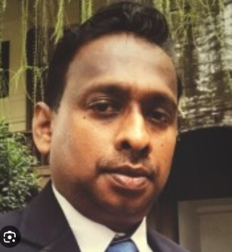






Team
Supervisor :
Mr. Uditha Dharmakeerthi
Co-Supervisor :
Mr. Amila Senarathne
Ellewela A.V.H
IT21361272
Rathnayaka K.P.Y.N
IT21031748
D.T.D Dissanayake
IT21165948
Silva K.H.L.D
IT21374838

Slide 3
Introduction To Overall Project
Increased reliance on fast and reliable delivery services highlights the need for efficiency in logistics.
Issues like unreliable delivery times, inefficient routing, and inadequate tracking systems lead to customer dissatisfaction.
Utilizing AI and Machine Learning can streamline processes, improve accuracy, and lower operational costs.
Enhancing communication and feedback mechanisms is crucial for improving the overall customer experience.
Develop a system to optimize delivery efficiency through automated voice activation, fleet management, and customer satisfaction analysis.

Slide 4
Research Questions
Main Question:
How can the integration of advanced technologies, such as AI, Machine Learning, and automated systems, enhance the efficiency and effectiveness of the item delivery process in eCommerce?
Sub-Questions:
How can an automated voice system enhance delivery time predictions and communication?
What metrics can analyze employee performance and drive improvements in delivery efficiency?
How does a fleet management system with route optimization affect delivery times and costs?
How can voice-based feedback effectively measure customer satisfaction (CSAT) and inform service improvements?

Slide 5
Objectives
Main Objective
To Implement a system to increase the effectiveness and efficiency in item delivery process.
Sub Objectives
To Implement an automated voice activation system for the courier service to enhance delivery time prediction.
To Recognize the employee behavior and identify the improvements as a percentage.
To Implement a fleet management system with path optimization and delivery time prediction.
To Analyze customer satisfaction(CAST) regarding the item delivery though voice-based feedback.

Slide 6
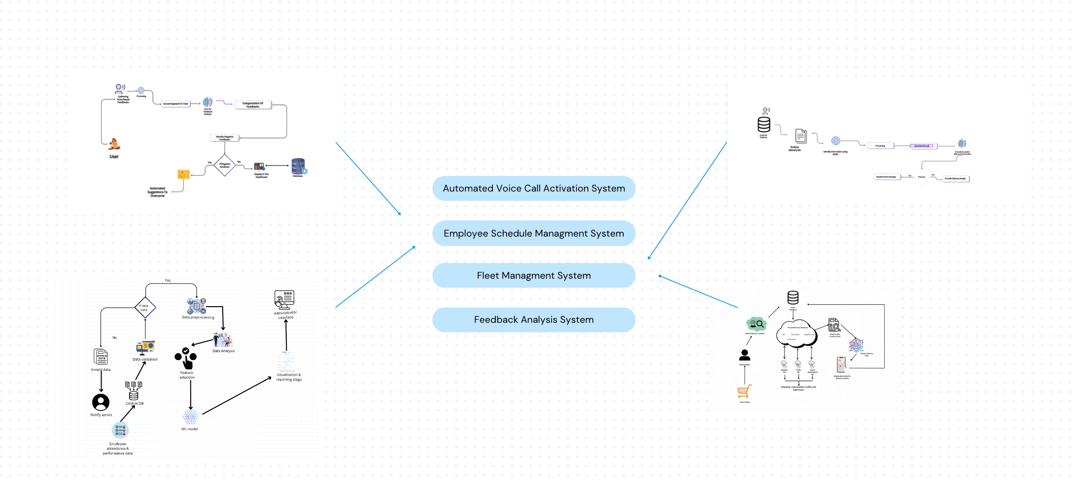
Overall System Diagram

Slide 7
IT21361272 | Ellewela A.v.h
Implement an automated voice system activation system for the courier service to enhance delivery time prediction.
Information Technology(IT)
IT21361272 | Ellewela A.V.H | 24-25J-298

Slide 8
INTRODUCTION
IT21361272 | Ellewela A.V.H | 24-25J-298

Slide 9
Background
Customers expect accurate, real-time delivery updates in today's eCommerce landscape.
Manual tracking and updates lead to delays and inaccurate delivery time predictions.
Voice activation and NLP now enable real-time, automated communication in delivery systems.
Automating voice updates improves delivery time accuracy and enhances customer satisfaction.
IT21361272 | Ellewela A.V.H | 24-25J-298

Slide 10
Research Gap
Research Paper | Objectives & Tasks
 | Real-time Data Collection and Preprocessing | Automated system confirms the delivery details with the customer before dispatch | Generate an automated call upcoming delivery | Automatically identify the scheduled delivery time
Dual Graph Multitask Framework for Imbalanced Delivery Time Estimation [1] | ✔️ | ❌ | ❌ | ❌
Case study on delivery time determination using a machine learning approach in small batch production companies[2] | ✔️ | ❌ | ❌ | ✔️
Voice‐based AI in call center customer service: A natural field experiment[3] | ✔️ | ❌ | ✔️ | ❌
IT21361272 | Ellewela A.V.H | 24-25J-298

Slide 11
Research Questions
Problem Statement:
Manual tracking causes delays and inaccurate delivery predictions in courier services, leading to customer dissatisfaction. An automated voice activation system can improve real-time updates and accuracy, addressing this issue?
Key Challenges:
Scaling the system to handle large volumes of deliveries and ensuring real-time performance across multiple regions requires robust infrastructure and optimization.
Safeguarding sensitive customer and delivery data collected through voice interactions is crucial, especially when dealing with personal information.
The voice activation system must function consistently, even in challenging conditions like poor network connectivity or device issues, to ensure smooth delivery operations.
IT21361272 | Ellewela A.V.H | 24-25J-298

Slide 12
Enhance real-time communication between couriers and customers through voice-based updates, improving delivery accuracy and customer satisfaction.
Specific and Sub Objectives
Specific Objective: To implement an automated voice activation system that improves delivery time prediction by providing real-time updates, enhancing communication between couriers and customers, and ensuring accurate and timely delivery information.
Sub Objectives:
To Create a voice-activated system that allows users to interact with courier services to receive and manage delivery time predictions seamlessly.
To Enhance real-time communication between couriers and customers through voice-based updates, improving delivery accuracy and customer satisfaction.
IT21361272 | Ellewela A.V.H | 24-25J-298

Slide 13
Methodology
IT21361272 | Ellewela A.V.H | 24-25J-298

Slide 14
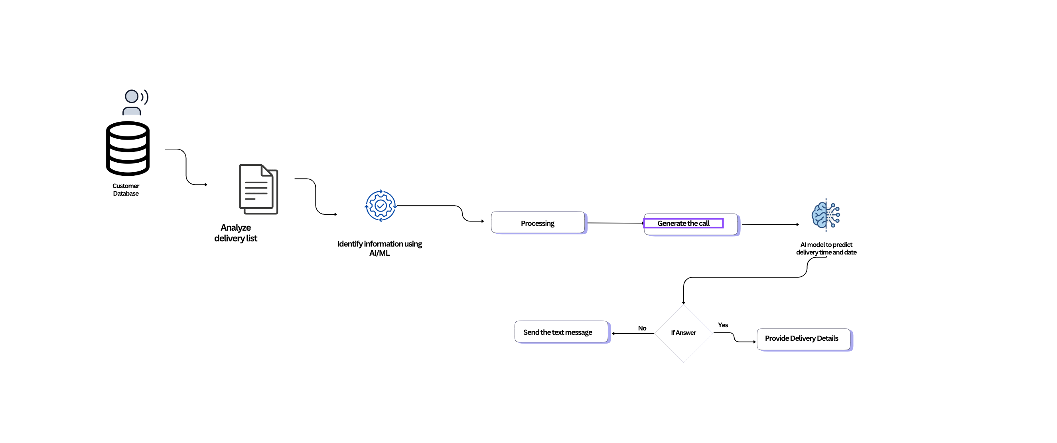
System Diagram
IT21361272 | Ellewela A.V.H | 24-25J-298

Slide 15
Technologies to be Used
Technology:
MongoDB
Asterisk-PBX
Python
Machine Learning
Calibration Methods:
Voice Recognition Calibration
Performance Metrics Analysis
Error Correction Methods:
Contextual Understanding
Speech Recognition Adjustment
IT21361272 | Ellewela A.V.H | 24-25J-298

Slide 16
System, Personnel, and Software Requirements Specification
System Requirements:
Hardware: Microphone, Processing Unit
Connectivity: Reliable internet connection
Personnel Requirements:
Knowledge about Machine Learning
Knowledge about Programming Proficiency
Software Requirements:
Voice Recognition Software
Natural Language Processing (NLP) Tools
IT21361272 | Ellewela A.V.H | 24-25J-298

Slide 17
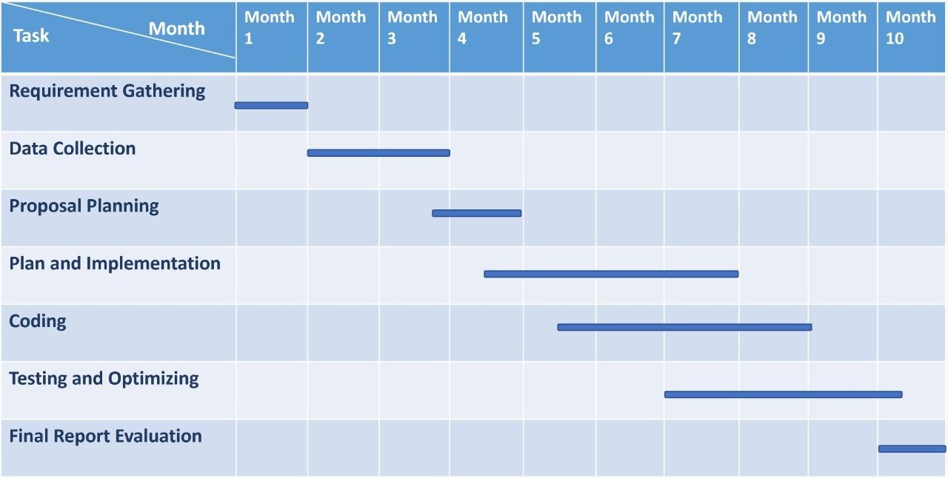
Gantt Chart
IT21361272 | Ellewela A.V.H | 24-25J-298

Slide 18
Commercialization
Market Potential:
Identify key segments such as e-commerce businesses, logistics companies, and delivery service providers that require efficient delivery systems.
Benefits:
Voice activation allows for quick updates and instructions, reducing the time spent on manual communication.
Automation decreases the need for manual tracking and communication, resulting in lower labor costs.
IT21361272 | Ellewela A.V.H | 24-25J-298

Slide 19
Budget
ITEM | COST
Voice Recognition Software Customization | $10
NLP/AI Services | $50
Processing Unit | $20
Microphones/Voice-Activated Devices | $15
Basic Integration with Existing Courier Systems | $12
Other cost | $20
Total Cost Per Floating Device | $127
IT21361272 | Ellewela A.V.H | 24-25J-298

Slide 20
References
[1] Dual Graph Multitask Framework for Imbalanced Delivery Time Estimation(https://www.researchgate.net/publication/368540469_)
[2] Case study on delivery time determination using a machine learning approach in small batch production companies
(https://www.researchgate.net/publication/377361016_)
[3] Voice‐based AI in call center customer service: A natural field experiment
(https://www.researchgate.net/publication/367362952)
[4] Determinants of Courier Service Quality in e-Commerce from Customers’ Perspective
(https://www.researchgate.net/publication/343422476 )
IT21361272 | Ellewela A.V.H | 24-25J-298

Slide 21

IT21165634 | RathnAyaka K.P.Y.N
Recognized the employee behaviour and identify the improvements as a percentage.
Information Technology(IT)
IT21031748 | Rathnayaka K.P.Y.N | 24-25J-298

Slide 22
INTRODUCTION
IT21031748 | Rathnayaka K.P.Y.N | 24-25J-298

Slide 23
Background
1. Employee Performance Data Collection
Track key metrics such as attendance, delivery times, task completion, and customer feedback.
2. Comprehensive Data Analyse
Analyse employee behaviour across various time frames (peak hours, holidays, etc.) to identify patterns and workload distribution.
3. Workforce Optimization
Evaluate the need for additional staffing during peak times or reduced staffing during off-peak periods using historical data
IT21031748 | Rathnayaka K.P.Y.N | 24-25J-298

Slide 24
Background
4. Machine Learning Model Implementation
Develop algorithms to predict future staffing needs and employee performance based on behavior trends and seasonal demand patterns.
5. Operational Efficiency and Forecasting
Generate forecasts of future schedules and performance metrics to optimize resource allocation and improve overall productivity.
IT21031748 | Rathnayaka K.P.Y.N | 24-25J-298

Slide 25
Research Gap
Research Paper | Objectives & Tasks
 | Tracking employee performance and work schedules by gathering attendance, performance data, and related metrics. | Analyzing data to ensure coverage across business hours, peak times, and holidays. | Analyzing workflow and workload to decide if more staff are needed. | Display forecasted schedules, performance criteria, and staffing needs to administrators
Employee Recognition, Task Performance, and OCB: Mediated and Moderated by Pride[1] | ✔️ | ❌ | ❌ | ✔️
The Key Strategies for Measuring Employee Performance in Companies: A Systematic Review[2] | ✔️ | ❌ | ✔️ | ❌
Role of Work Breaks in Well-Being and Performance[3] | ❌ | ✔️ | ✔️ | ❌
IT21031748 | Rathnayaka K.P.Y.N | 24-25J-298

Slide 26
Research Questions
How can machine learning algorithms be applied to predict future staffing needs and optimize employee performance based on behaviour patterns?
What is the impact of predictive staffing solutions on improving delivery times and customer satisfaction?
What are the key performance metrics that influence employee efficiency in a delivery system?
How can machine learning models be designed to accurately forecast staffing needs during peak and off-peak times?
How does analyzing individual employee behaviour improve overall workforce management and operational efficiency?
IT21031748 | Rathnayaka K.P.Y.N | 24-25J-298

Slide 27
Main Objective
To develop a machine learning-based system that predicts future staffing needs and enhances employee performance by analysing behaviour patterns, thereby improving operational efficiency and resource allocation.
Sub Objectives
Data Collection: Gather and organize employee performance data, including attendance, task completion rates, and work schedules.Establish a routing mechanism to select best path.
Behaviour Analysis : Analyse employee behaviour patterns across peak hours, holidays, and normal business hours to identify workload distribution.
Machine Learning Implementation: Develop and implement machine learning algorithms to predict future staffing requirements and optimize workforce efficiency.
Performance Forecasting: Provide insights and forecasts for staffing schedules and performance improvements to aid in workforce planning and decision-making.
IT21031748 | Rathnayaka K.P.Y.N | 24-25J-298

Slide 28
METHODOLOGY
IT21031748 | Rathnayaka K.P.Y.N | 24-25J-298

Slide 29
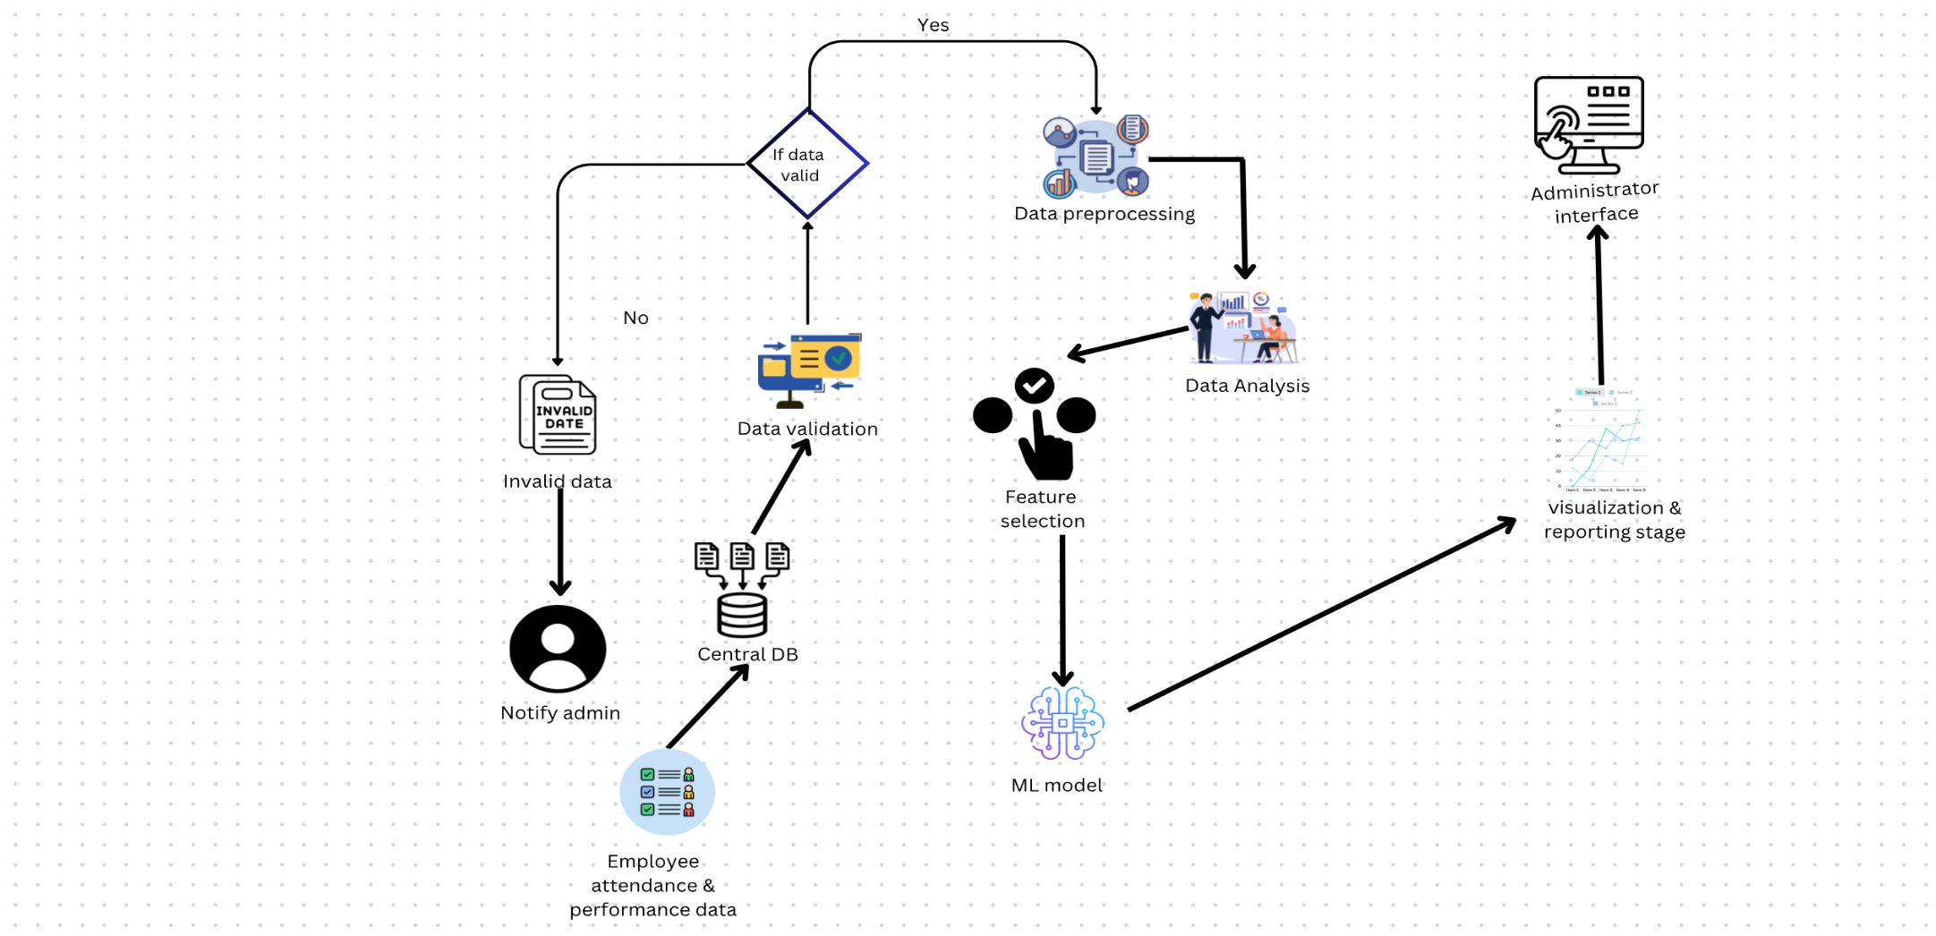
System Diagram
IT21031748 | Rathnayaka K.P.Y.N | 24-25J-298

Slide 30
Technologies
1. Data Collection
Tools: TSheets (attendance) and BambooHR (performance).
2. Data Processing
Technology: Python with Pandas.
3. Behavior Analysis:
Tools: R, Tableau, and Matplotlib.
4. Machine Learning:
Frameworks: TensorFlow and Scikit-learn.
5. Performance Evaluation:
Metrics: Accuracy and precision with Scikit-learn.
6. Reporting:
Tools: Tableau or Power BI.
7. NLP:
Libraries: NLTK, and Google Cloud Speech-to-Text.
IT21031748 | Rathnayaka K.P.Y.N | 24-25J-298

Slide 31
Requirements
Hardware Requirements
Computers/Servers: For data processing and model training.
Data Collection Devices:
Attendance tracking devices (e.g., RFID readers).
Performance monitoring sensors (if applicable).
Personal Requirements
Knowledge:
Proficiency in data analysis and statistics.
Familiarity with machine learning algorithms and frameworks (e.g., TensorFlow, Scikit-learn).
Understanding of data visualization tools (e.g., Tableau, Power BI).
Software Requirements
Data Processing Tools:
Python: For data analysis and modelling (with libraries like Pandas, NumPy, etc.).
Machine Learning Frameworks:
TensorFlow or Scikit-learn: For building and training machine learning models.
Data Visualization Tools:
Tableau or Power BI: For reporting and visualizing insights.
IDE/Code Editors:
Jupiter Notebook or PyCharm: For writing and testing code.
IT21031748 | Rathnayaka K.P.Y.N | 24-25J-298

Slide 32
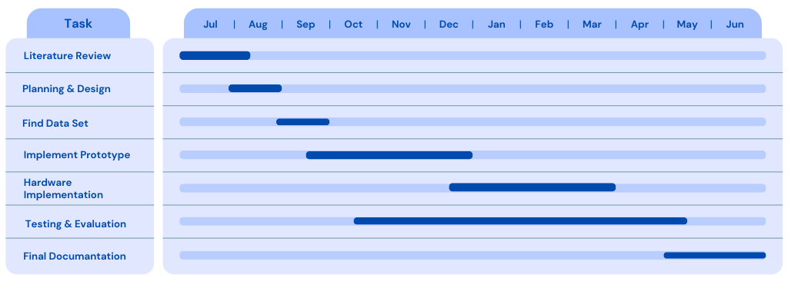
Gantt Chart
IT21031748 | Rathnayaka K.P.Y.N | 24-25J-298

Slide 33
SUPPORTING ITEMS
IT21031748 | Rathnayaka K.P.Y.N | 24-25J-298

Slide 34
Commercialization
. Market Demand for Employee Performance Optimization
Growing Need in Workforce Management: Organizations are increasingly seeking advanced solutions to monitor and enhance employee performance, driven by the need for improved productivity and operational efficiency across various industries.
2. Scalability of the Solution
Flexibility for Diverse Organizations: The system is designed to adapt to various organizational sizes and structures, enabling the integration of additional performance metrics and tools as needed to meet evolving business requirements.
3. Cost-Effective Operation
Minimized Operational Costs: By automating the collection and analysis of employee performance data, the solution reduces reliance on manual evaluations and frequent oversight, significantly lowering operational expenses while improving workforce efficiency.
IT21031748 | Rathnayaka K.P.Y.N | 24-25J-298

Slide 35
Budget
Item | Cost
GPS Devices | $60
Server/Cloud Storage | $60
Total Cost for One Boat | $112
IT21031748 | Rathnayaka K.P.Y.N | 24-25J-298

Slide 36
REFERENCES
IT21031748 | Rathnayaka K.P.Y.N | 24-25J-298

Slide 37
[1] Employee Recognition, Task Performance, and OCB: Mediated and Moderated by Pride(https://www.mdpi.com/2071-1050/14/3/1631 )
[2] The Key Strategies for Measuring Employee Performance in Companies: A Systematic Review(https://www.researchgate.net/publication/367528681 )
[3] Role of Work Breaks in Well-Being and Performance(https://www.researchgate.net/publication/361913348_ )
[4] Putting the System Into Performance Management Systems: A Review and Agenda for Performance Management Research(https://www.researchgate.net/publication/323040479_ )
[5] Employee Recognition and Performance:A Field Experiment(https://people.duke.edu/~dandan/webfiles/PapersPayoff/Scarcity_02June2015.pd )
IT21031748 | Rathnayaka K.P.Y.N | 24-25J-298

Slide 38

IT21165948 | D.T.D DISSANAYAKE
Implement a fleet management system with delivery path optimization and delivery time prediction
Information Technology(IT)

Slide 39
INTRODUCTION
IT21165948 | D.T.D Dissanayake | 24-25J-298

Slide 40
Background
Traditional manual route planning in fleet management is inefficient, causing delays and higher fuel costs. Optimizing routes solves these problems.
Predicting delivery times is essential to satisfy customer demand for faster and more accurate deliveries.
A fleet management system with optimized delivery paths can easily scale to handle more deliveries, improving efficiency during peak times.
IT21165948 | D.T.D Dissanayake | 24-25J-298

Slide 41
Research Gap
Research Paper | Objectives & Tasks
 | Collect live weather data, track real-time traffic, and analyze the shortest routes to optimize delivery paths. | Predict delivery times by considering historical delivery data, traffic, and weather factors. | Track total deliveries, delivery time, and gather feedback for analysis to improve performance.
A Real-time Vehicle Routing Model for a Courier Service Problem[1] | ❌ | ❌ | ✔️
Research on Optimization of Vehicle Routing Problem for Ride-sharing Taxi[2] | ❌ | ✔️ | ❌
Case study on delivery time determination using a machine learning approach in small batch production | ❌ | ✔️ | ❌
IT21165948 | D.T.D Dissanayake | 24-25J-298

Slide 42

Research Question
How can the integration of advanced route optimization algorithms and predictive analytics in a fleet management system enhance delivery efficiency and accuracy in item delivery processes?
IT21165948 | D.T.D Dissanayake | 24-25J-298

Slide 43
Specific Objectives
To create and implement algorithms that dynamically optimize delivery routes based on real-time traffic data and vehicle conditions.
To enhance the system’s ability to predict delivery times accurately by analyzing historical data and current variables affecting delivery performance.
To maximize the operational efficiency of the fleet by implementing strategies that reduce idle time and improve resource allocation.
IT21165948 | D.T.D Dissanayake | 24-25J-298

Slide 44
Sub Objectives
To automate the route planning process, reducing the time required for manual planning and increasing delivery speed.
To integrate real-time data from GPS, traffic reports, and weather conditions into the fleet management system to enhance route optimization.
To analyze historical delivery data to identify patterns and factors that influence delivery times, enabling better predictions.
IT21165948 | D.T.D Dissanayake | 24-25J-298

Slide 45
Proposed Methodology
IT21165948 | D.T.D Dissanayake | 24-25J-298

Slide 46
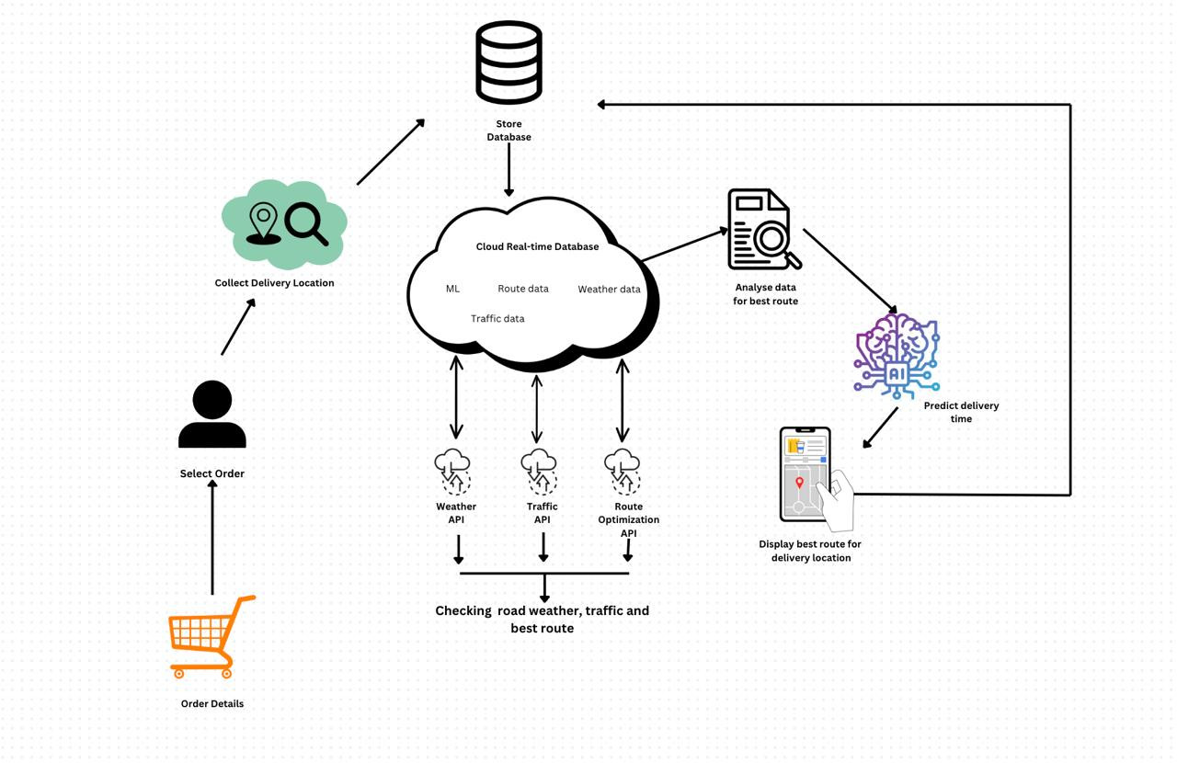
System Diagram
IT21165948 | D.T.D Dissanayake | 24-25J-298

Slide 47
Technologies
Mobile Applications Development tool
Implement cloud-based platforms
Machine Learning Algorithms
IT21165948 | D.T.D Dissanayake | 24-25J-298

Slide 48
Requirements
Hardware Requirements
GPS Devices
Mobile Devices
Server Infrastructure
Algorithms Requirements
Route Optimization Algorithms
Predictive Analytics Algorithms
Software Requirements
Fleet Management Software
Mapping and Routing Software
Data Analytics Tools
IT21165948 | D.T.D Dissanayake | 24-25J-298

Slide 49
Gannt Chart
IT21165948 | D.T.D Dissanayake | 24-25J-298

Slide 50
SUPPORTING ITEMS
IT21165948 | D.T.D Dissanayake | 24-25J-298

Slide 51
Commercialization
Market Potential:
Evaluate existing solutions in the market, their features, pricing models, and market share to identify gaps and opportunities.
Competitive Advantage:
Advanced Technology.
Enhanced Customer Experience
Real-Time Analytics
User-Friendly Interface
IT21165948 | D.T.D Dissanayake | 24-25J-298

Slide 52
Budget
Item | Cost
API Cost | $60
GPS Devices | $30
Unexpected Costs | $20
Total Cost | $110
IT21165948 | D.T.D Dissanayake | 24-25J-298

Slide 53
REFERENCES
IT21165948 | D.T.D Dissanayake | 24-25J-298

Slide 54
[1] A Real-time Vehicle Routing Model for a Courier Service Problem
(https://www.researchgate.net/publication/227281341_ )
[2] Research on Optimization of Vehicle Routing Problem for Ride-sharing Taxi
(https://www.sciencedirect.com/science/article/pii/S1877042812010038)
[3] Case study on delivery time determination using a machine learning approach in small batch production
(https://link.springer.com/article/10.1007/s10845-023-02290-2)
[4] Boosting Algorithms for Delivery Time Prediction in Transportation Logistics
(https://ieeexplore.ieee.org/document/9346325)
IT21165948 | D.T.D Dissanayake | 24-25J-298

Slide 55
IT21374838 | SILVA K.H.L.D
Securely process, Manage, and visualize data in the cloud.
Information Technology(IT)

Slide 56
Background
Traditional methods of customer feedback collection, like surveys, are limited in real-time analysis and engagement.
Voice-based feedback offers a more interactive way for customers to express their opinions, leading to richer data.
Best use of AI and NLP
IT21374838 | Silva K.H.L.D | 24-25J-298

Slide 57
Research Problem
How can a voice-based feedback system using AI and Natural Language Processing (NLP) improve the collection and analysis of customer opinions to enhance service delivery and overcome the limitations of traditional feedback methods?
IT21374838 | Silva K.H.L.D | 24-25J-298

Slide 58
Research Gap
Research Paper | Objectives & Tasks
 | Gathering Feedbacks Using Voice Based Techniques | Speech To Text Conversion | Analyze Data And Categorization Of Feedbacks | Providing Systematic Suggestions
[1] | ✔️ | ❌ | ❌ | ❌
[2] | ✔️ | ❌ | ❌ | ❌
[3] | ✔️ | ❌ | ❌ | ❌
IT21374838 | Silva K.H.L.D | 24-25J-298

Slide 59
Objectives
Main Objective: To enhance customer satisfaction by developing a system that accurately analyses voice-based feedback using AI and NLP.
IT21374838 | Silva K.H.L.D | 24-25J-298

Slide 60
Sub Objectives:
1) Implement a robust system to collect voice feedback through various platforms (e.g., mobile app, IVR).
2) Develop an efficient method to convert voice recordings into text using Speech-to-Text technology.
3) Use NLP to analyze the feedback, categorize negative comments, and identify key themes.
4) Provide automated suggestions for improving service based on the categorized feedback.
5) Display a summarized dashboard view of the feedback for managers in a clear and actionable format.
IT21374838 | Silva K.H.L.D | 24-25J-298

Slide 61
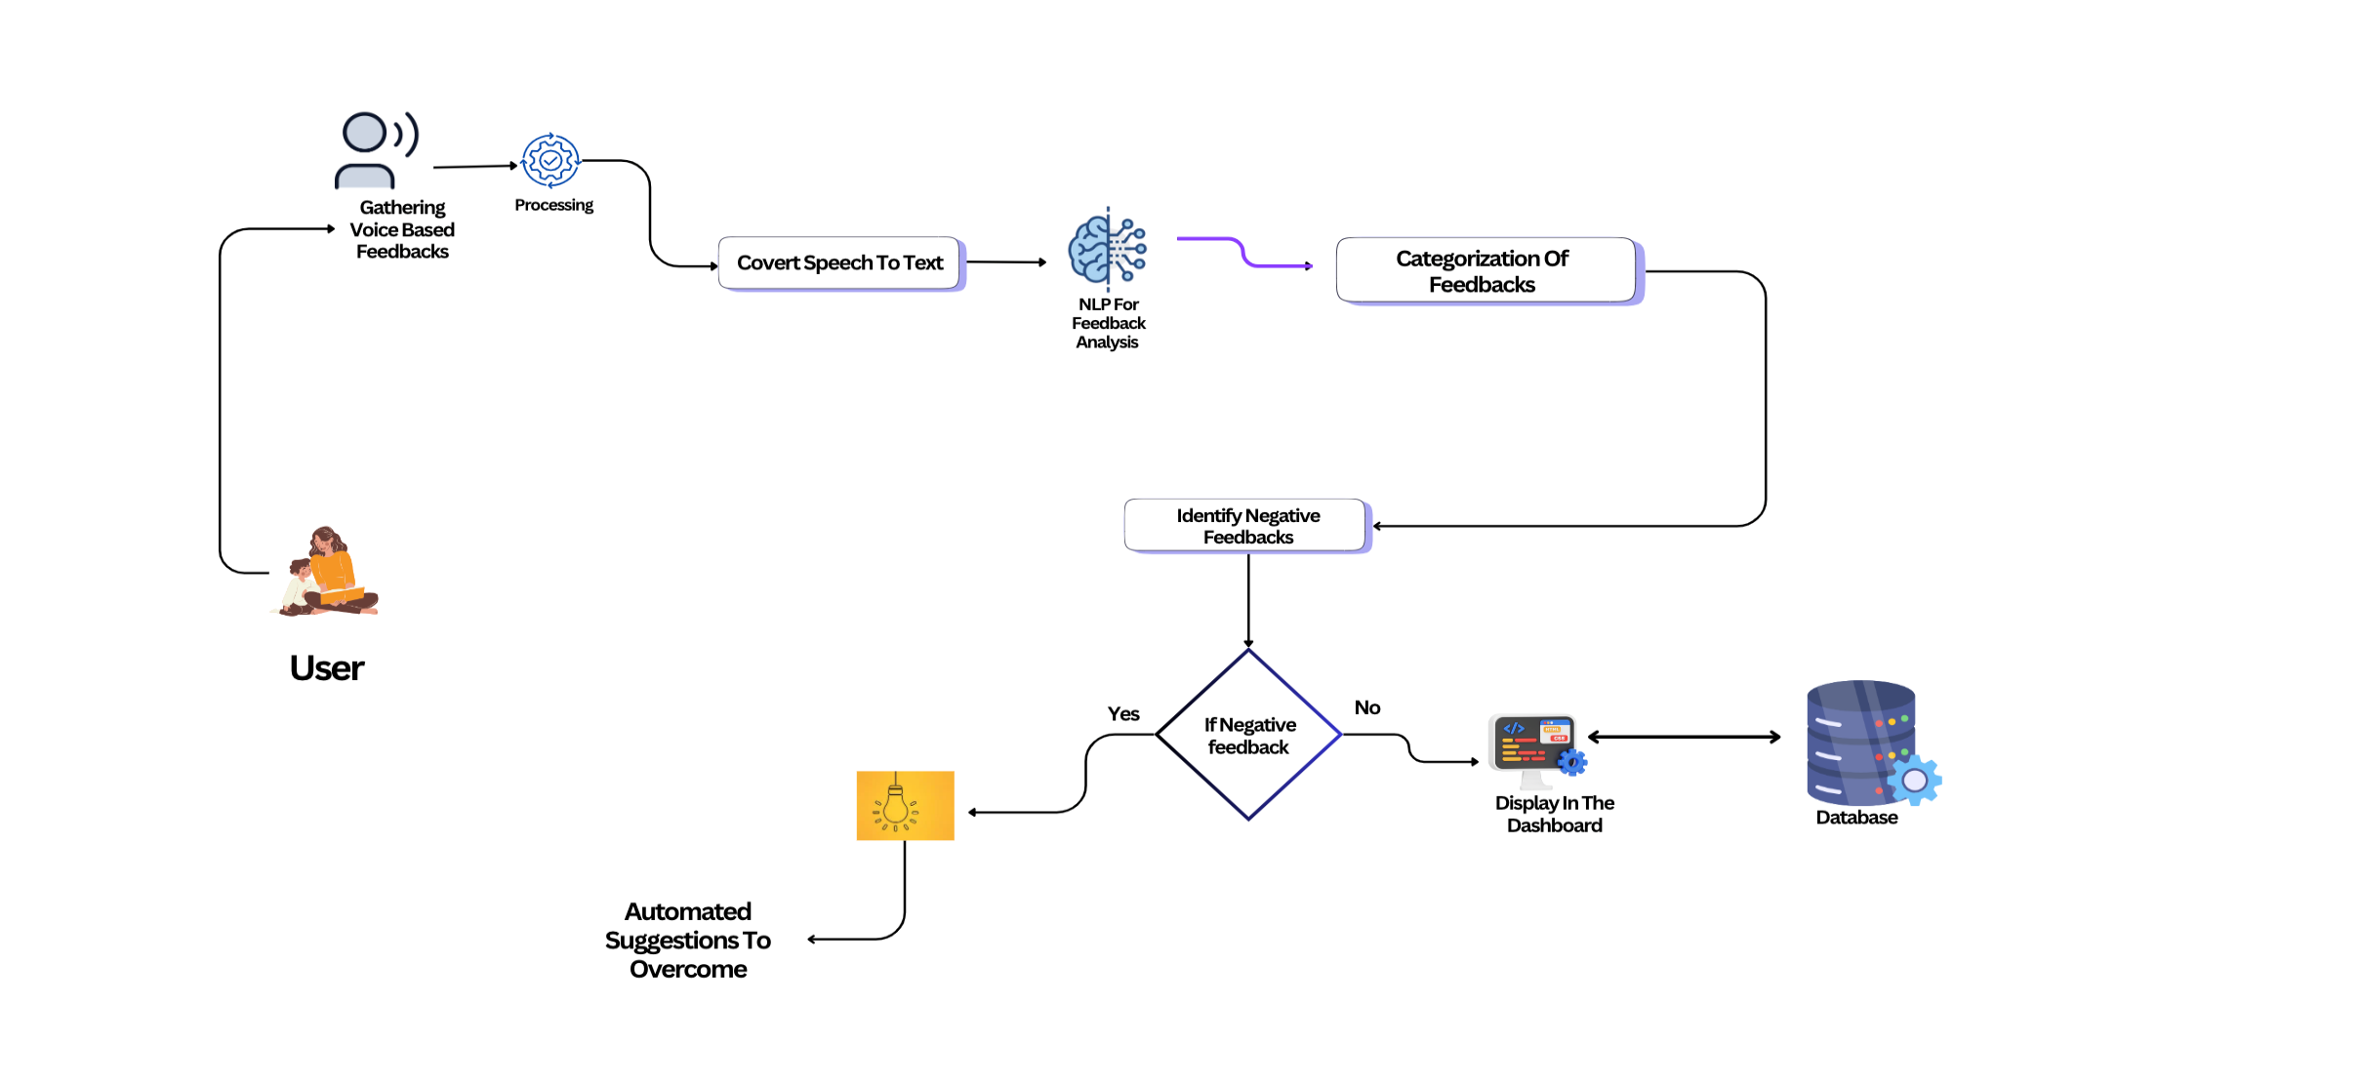
System diagram
IT21374838 | Silva K.H.L.D | 24-25J-298

Slide 62
Technologies
Voice Collection Tools:
IVR systems
Speech-to-Text Conversion:
Google Cloud Speech-to-Text
Microsoft Azure Speech API
Natural language processing (NLP).
Machine learning algorithms.
Classification algorithms.
React, Javascript Libraries.
IT21374838 | Silva K.H.L.D | 24-25J-298

Slide 63
Requirements
System Requirements:
Voice Recording Collection
Devices with microphones or IVR systems.
Speech-to-Text Conversion
Use APIs like Google Cloud or Azure.
Tools to improve audio quality.
Storage for audio and ext data.
NLP for Feedback Analysis
Use AI tools like Google Cloud NLP.
Feedback Categorization
Machine learning to group feedback
Labelled data to train models.
Automated Suggestions
AI based recommendations models.
Dashboard Summary Display
IT21374838 | Silva K.H.L.D | 24-25J-298

Slide 64
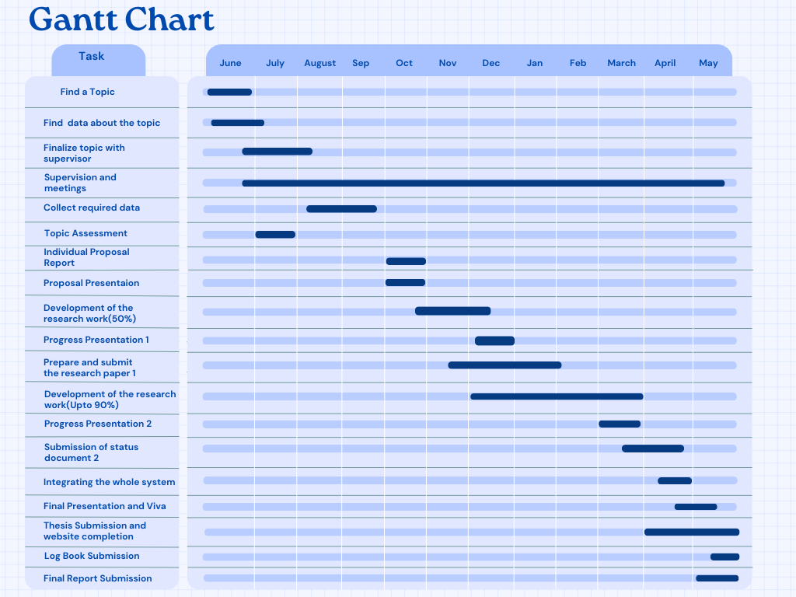
Gantt Chart
IT21374838 | Silva K.H.L.D | 24-25J-298

Slide 65
Commercialization
Market Potential:
Emphasize the competitive advantage of using voice-based feedback over traditional text-based methods for real-time customer insights.
Competitive Advantage:
Focus on businesses that want to improve customer experience through more accurate feedback analysis.
Revenue Model
IT21374838 | Silva K.H.L.D | 24-25J-298

Slide 66
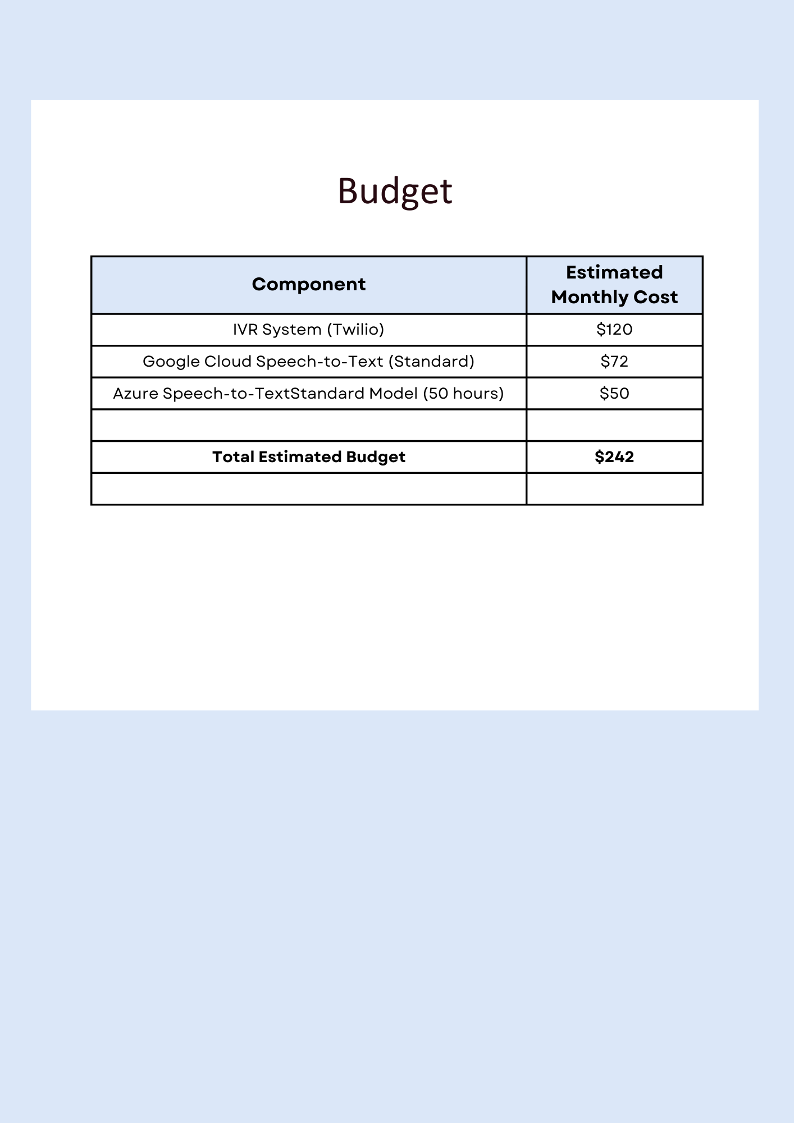
Budget
IT21374838 | Silva K.H.L.D | 24-25J-298

Slide 67
References
[1] NLP techniques for automating responses to customer queries: a systematic review," Discover Artificial Intelligence.(https://link.springer.com/article/10.1007/s44163-023-00065-5)
[2] Choi et al., "Impact of Voice Commerce on Customer Satisfaction in Comparison with E-commerce," ResearchGate. Available: https://www.researchgate.net/publication/365489357.
[3] M. Faraon and K. Rönkkö, "VoiceBack: Design of Artificial Intelligence-Driven Voice-Based Feedback System for Customer-Agency Communication in Online Travel Services," Information, vol. 15, no. 8, pp. 468, 2024. Available: https://doi.org/10.3390/info15080468.
IT21374838 | Silva K.H.L.D | 24-25J-298

Slide 68
Thank You!

